Slide 1
Intermediate Coding Week 9
Arraylists

Slide 2

Interfaces Review

Slide 3
Quick Inheritance reminder:
inheritance: A way to form new classes based on existing classes, taking on their attributes/behavior.
a way to group related classes
a way to share code between two or more classes
One class can extend another, absorbing its data/behavior.
superclass: The parent class that is being extended.
subclass: The child class that extends the superclass and inherits its behavior.
Subclass gets a copy of every field and method from superclass

Slide 4
Interfaces
interface: A list of methods that a class can implement.
Inheritance gives you an is-a relationship and code-sharing.
A Baby Zombie object can be treated as an Zombie, and Baby Zombie inherits Zombie’s code.
Interfaces give you an is-a relationship without code sharing.
A Cow object can be treated as a Mob.
Analogous to the idea of roles or certifications:
“I am a Mob. That means I know how to drop items and make noises."
"I’m certified as a Shape. That means I know how to compute my area and perimeter."

Slide 5
Declaring an interface
public interface name {
public type name(type name, ..., type name);
public type name(type name, ..., type name);
...
}
Example:
public interface Vehicle {
public double speed();
public void setDirection(int direction);
}
abstract method: A header without an implementation.
The actual body is not specified, to allow/force different classes to implement the behavior in its own way.

Slide 6
Shape interface
public interface Mob {
public void drop();
public void makeNoise();
}
This interface describes the features common to all mobs. (Every mob drops something and makes some noise)

Slide 7
Question 1 – Inheritance and Constructors (Continued from last week, see Week 15 Question 1 and 2 for info)
Imagine that we want to give employees more vacation days the longer they've been with the company.
For each year worked, we'll award 2 additional vacation days.
This means we’ll need a new field for the number of years the person has been in the company.
When an Employee object is constructed, we'll pass in the number of years the person has been with the company.
Make sure you create new constructors for all of the classes!

Slide 8

ArrayLists
Notes:
Skip if it’s already past 4:35.

Slide 9
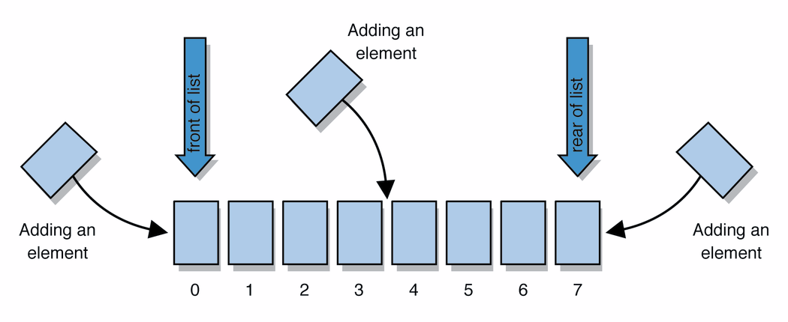
Lists
list: a collection storing an ordered sequence of elements
each element is accessible by a 0-based index
a list has a size (number of elements that have been added)
elements can be added to the front, back, or elsewhere
in Java, a list can be represented as an ArrayList object
Notes:
use jGRASP/DrJava Interactions window to create a list and add some elements, get them, check size

Slide 10
Idea of a list
Rather than creating an array of boxes, create an object that represents a "list" of items. (initially an empty list.)
[]
You can add items to the list.
The default behavior is to add to the end of the list.
[hello, ABC, goodbye, okay]
The list object keeps track of the element values that have been added to it, their order, indexes, and its total size.
Think of an "array list" as an automatically resizing array.
Internally, the list is implemented using an array and a size field.

Slide 11
ArrayList methods
add(value) | appends value at end of list
add(index, value) | inserts given value just before the given index, shifting subsequent values to the right
clear() | removes all elements of the list
indexOf(value) | returns first index where given value is found in list (-1 if not found)
get(index) | returns the value at given index
remove(index) | removes/returns value at given index, shifting subsequent values to the left
set(index, value) | replaces value at given index with given value
size() | returns the number of elements in list
toString() | returns a string representation of the list such as "[3, 42, -7, 15]"

Slide 12
Type Parameters (Generics)
ArrayList<Type> name = new ArrayList<Type>();
When constructing an ArrayList, you must specify the type of elements it will contain between < and >.
This is called a type parameter or a generic class.
Allows the same ArrayList class to store lists of different types.
ArrayList<String> names = new ArrayList<String>();
names.add("George Washington");
names.add("John Adams");

Slide 13
ArrayList vs. array
construction
String[] names = new String[5];
ArrayList<String> list = new ArrayList<String>();
storing a value
names[0] = "Jessica";
list.add("Jessica");
retrieving a value
String s = names[0];
String s = list.get(0);

Slide 14
ArrayList vs. array continued
doing something to each value that starts with "B"
for (int i = 0; i < names.length; i++) {
if (names[i].startsWith("B")) { ... }
}
for (int i = 0; i < list.size(); i++) {
if (list.get(i).startsWith("B")) { ... }
}
seeing whether the value “Bruce Wayne" is found
for (int i = 0; i < names.length; i++) {
if (names[i].equals("Bruce Wayne")) { ... }
}
if (list.contains("Bruce Wayne")) { ... }

Slide 15
ArrayList as parameter
public static void name(ArrayList<Type> name) {
Example:
// Removes all plural words from the given list.
public static void removePlural(ArrayList<String> list) {
for (int i = 0; i < list.size(); i++) {
String str = list.get(i);
if (str.endsWith("s")) {
list.remove(i);
i--;
}
}
}
You can also return a list:
public static ArrayList<Type> methodName(params)

Slide 16
ArrayList of primitives?
The type you specify when creating an ArrayList must be an object type; it cannot be a primitive type.
// illegal -- int cannot be a type parameter
ArrayList<int> list = new ArrayList<int>();
But we can still use ArrayList with primitive types by using special classes called wrapper classes in their place.
// creates a list of ints
ArrayList<Integer> list = new ArrayList<Integer>();

Slide 17

Wrapper classes
Primitive Type | Wrapper Type
int | Integer
double | Double
char | Character
boolean | Boolean
A wrapper is an object whose sole purpose is to hold a primitive value.
Once you construct the list, use it with primitives as normal:
ArrayList<Double> grades = new ArrayList<Double>();
grades.add(3.2);
grades.add(2.7);
...
double myGrade = grades.get(0);

Slide 18
Out-of-bounds
Legal indexes are between 0 and the list's size() - 1.
Reading or writing any index outside this range will cause an IndexOutOfBoundsException.
ArrayList<String> names = new ArrayList<String>();
names.add("Adam");
names.add("Bella");
names.add("Carl");
names.add("Donna");
System.out.println(names.get(0)); // okay
System.out.println(names.get(3)); // okay
System.out.println(names.get(-1)); // exception
names.add(9, "Jill"); // exception
index | 0 | 1 | 2 | 3
value | Adam | Bella | Carl | Donna

Slide 19

Problems

Slide 20
Question 1
Write a method that removes all numbers larger than 100 and smaller than 0 from an ArrayList of integers. That is, after your method is called all of the integers in the ArrayList should be between 0 and 100.

Slide 21
Question 2
Write a method that adds a copy of each element currently in an ArrayList of strings to the end of the ArrayList.
For example, if the ArrayList contains the words {“yeet”, “yaheet”, “spleet”, “yoink”}, the ArrayList should contain {“yeet”, “yaheet”, “spleet”, “yoink”, “yeet”, “yaheet”, “spleet”, “yoink”} after the method is called.

Slide 22
LinkedLists
Notes:
Skip if it’s already past 4:35.

Slide 23

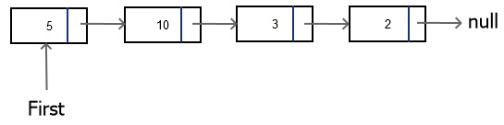
Linked Lists
A data structure that consists of nodes, where each node stores data and contains a pointer to the next node.

Slide 24
LinkedList vs. ArrayList
Both implement the interface List
You can add items, change items, remove items, and clear the list.
LinkedList and ArrayList function very similarly, but they are stored differently
ArrayList is implemented with an array and a size field
LinkedList is implemented as separate nodes with pointers to each other

Slide 25
LinkedList methods
addFirst(value) | adds value at beginning of list
addLast(value) | adds value at end of list
removeFirst() | removes first element of the list
removeLast() | removes last element of the list
getFirst() | returns first element of the list
getLast() | returns last element of the list

Slide 26
Question 3 (Challenge)
Using the LinkedListNode class we created during class, build a linked list of the integers {4, 8, 7, 2, 3, 5}, in that order.
Can you write code that allows you to insert nodes into the linked list like we talked about in class?

